Slide 1
Open-Source Tools for Monitoring Clinical Trial Safety
Taking it to the Next Level Towards Cross-Functional Collaboration
Jeremy Wildfire, Rho Inc
On behalf of the Interactive Safety Graphics Taskforce
jeremy_wildfire@rhoworld.com
@jwildfire

Slide 2
safetyGraphics R package
An open source framework for evaluation of clinical trial safety
Links: CRAN | GitHub | Demo

Slide 3
Agenda
Background & Motivation
Live Demo
Technical Framework
Case Study: Open Source Collaboration in Pharma
Next Steps
But first …

Slide 4
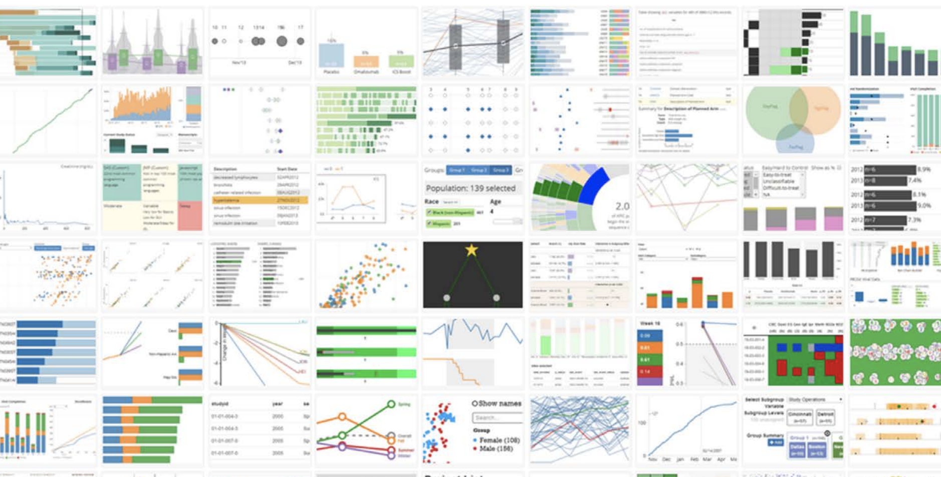
Background Interactive Graphics at Rho
https://rhoinc.github.io/graphics/

Slide 5
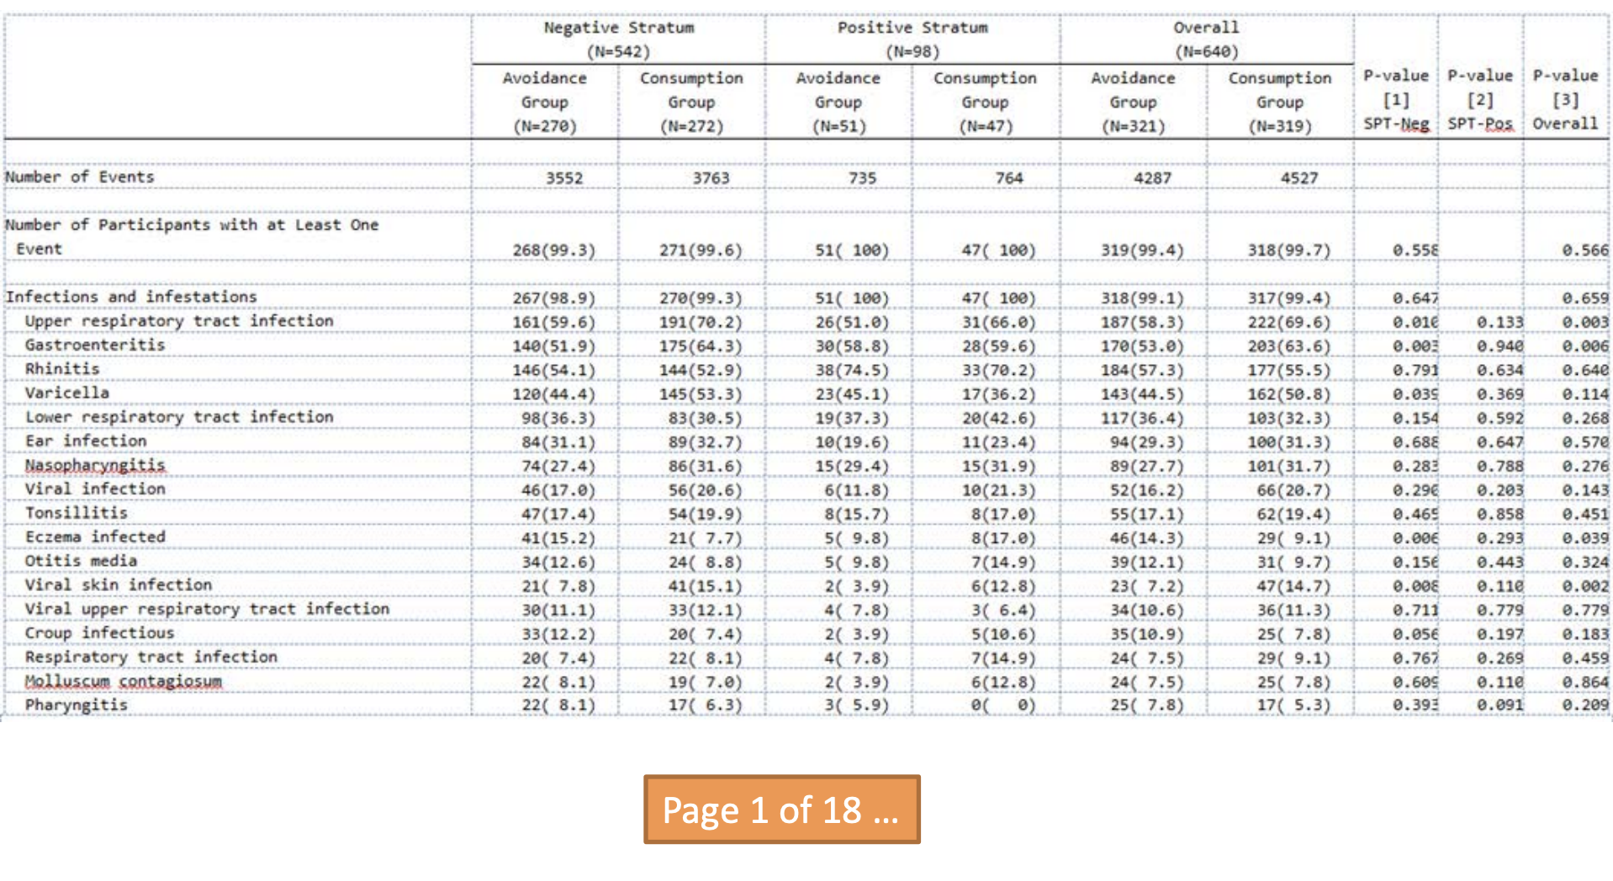
Background Standard Adverse Events Table

Slide 6
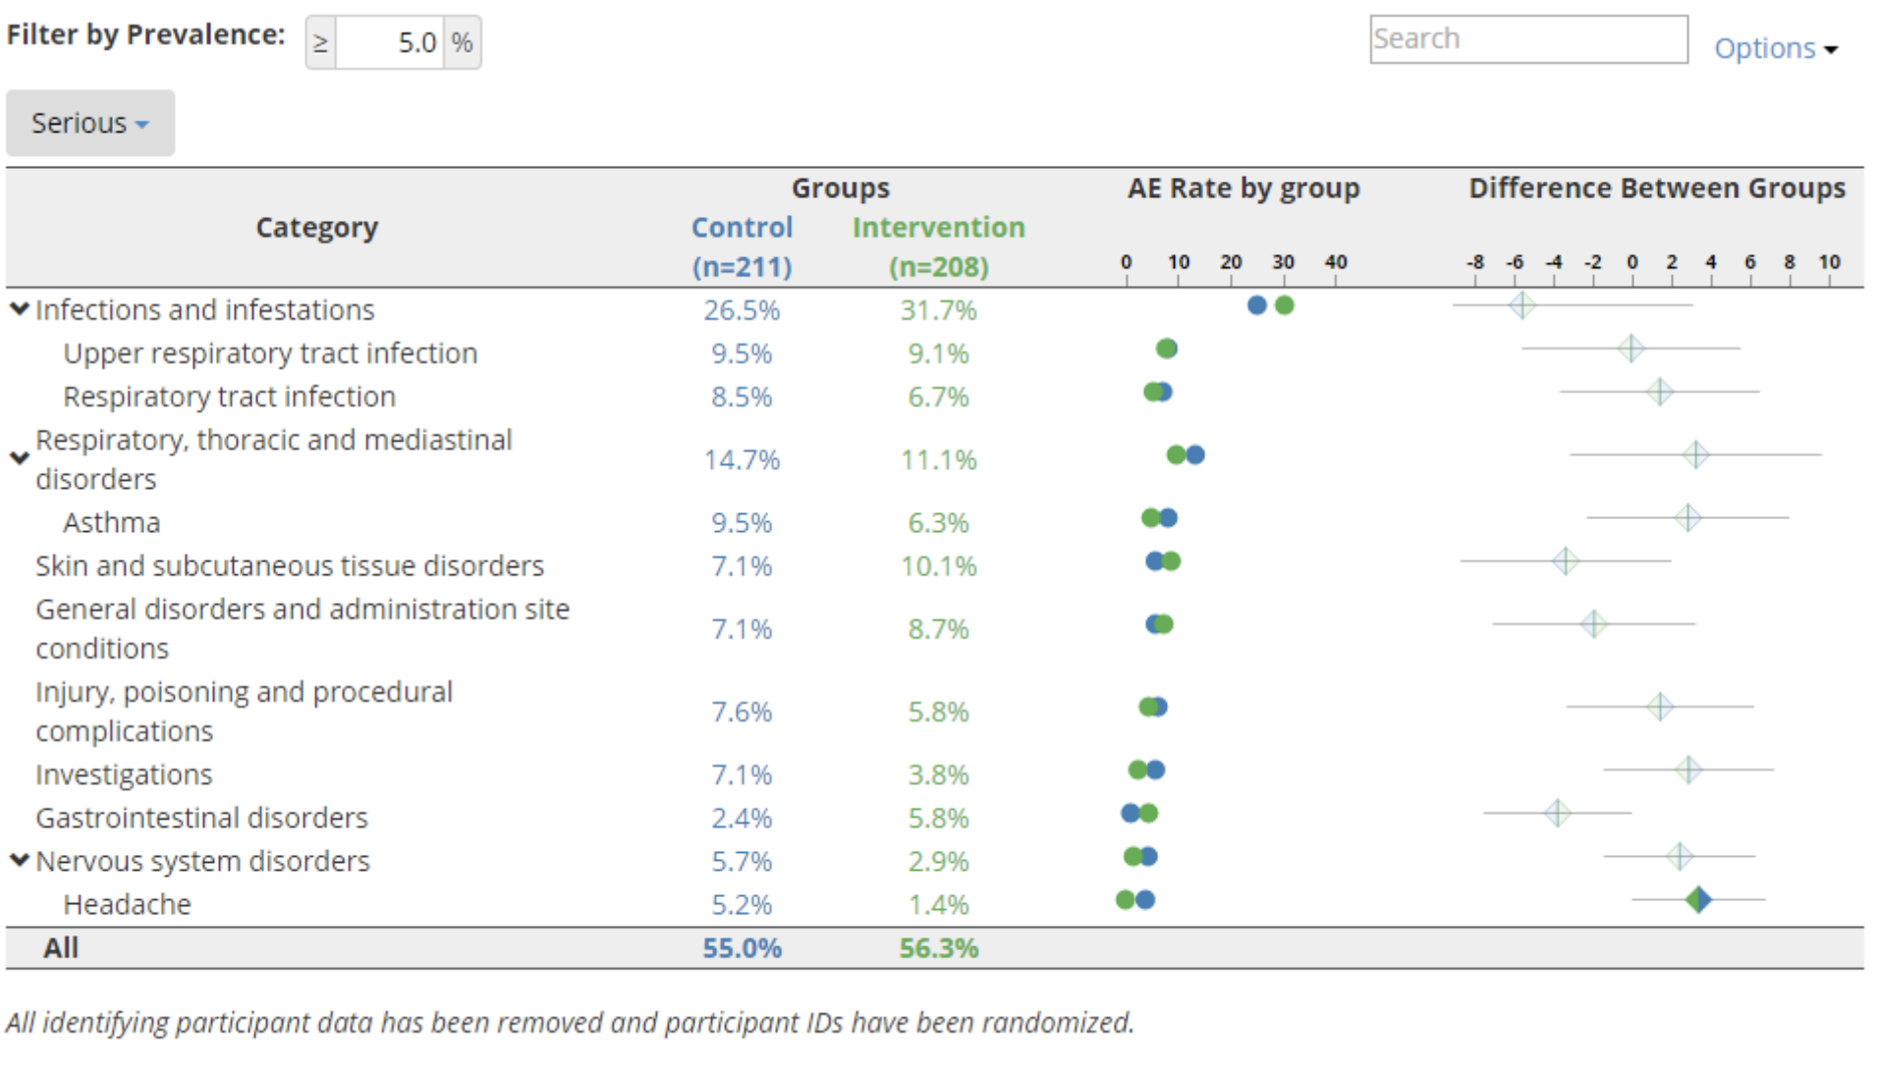
Background Interactive Adverse Events Table
Interactive Demo

Slide 7
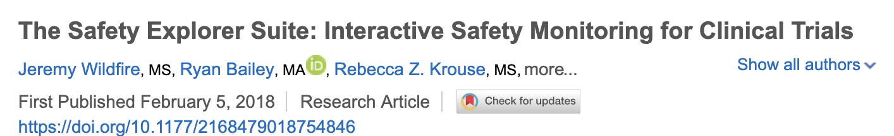
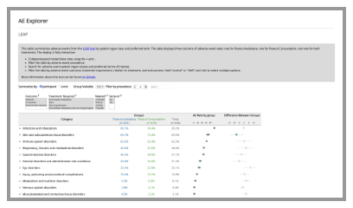
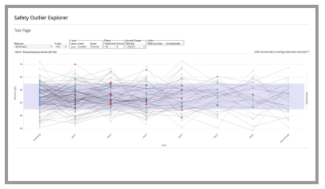
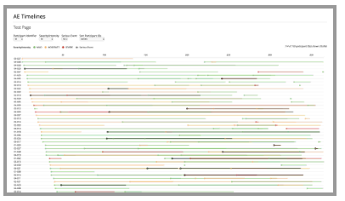
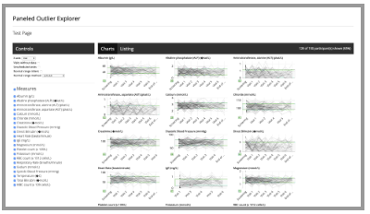
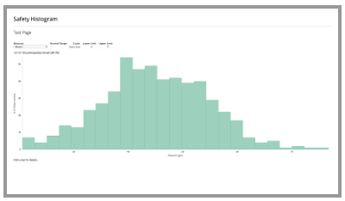
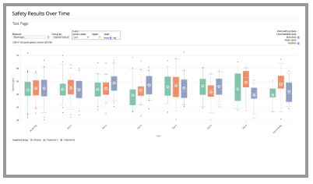
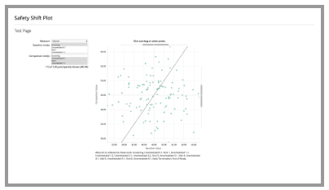
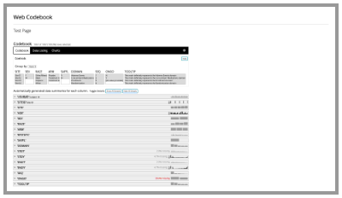
Background The Safety Explorer Suite
Therapeutic Innovation & Regulatory Science Manuscript

Slide 8
DIA – ASA Biopharm Safety Working Group
Safety Working Group Homepage
Mission: Empower the biostatistics community and interdisciplinary safety management partnerships to better enable qualitative and quantitative safety evaluation throughout drug development life cycle
Work Stream 1: Interdisciplinary Safety Evaluation
1a: Regulations, Framework and Aggregate Safety Assessment Plan
1b: Safety Monitoring, Evaluation and Identification of Risk
1c: Benefit-Risk Assessment Plan
Work Stream 2: Statistical Methodology for Safety Monitoring
Work Stream 3: Integration and Bridging Real World Evidence and Randomized Clinical Trials for Safety Decision Making
Interactive Safety Graphics
team lives here

Slide 9
Interactive Safety Graphics Task Force (ISG)
ISG Homepage
Guiding Principles: ISG is creating tools that are:
Open Source - Transparent. Customizable. Free!
Highly Collaborative - Clinicians and Programmers working together.
Interactive - Users can explore their data.
Easy to Use - Just open up a webpage.
Easy to Configure - Streamlined configuration with R.
Compliant with Data Standards - Support ADaM and SDTM by default.
Agile - Frequent releases with GitHub.
Engaging - Regular Feedback from users. Pilot testing. Open issue tracking.

Slide 10
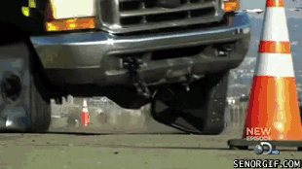


A brief distraction regarding … Open Source in Pharma
Current State: Lots of reinventing the Wheel.
Signs of Progress
Opening Up Clinical Trials: 7 Trends Towards Open Source – Jeremy Wildfire (Rho)
Using R in a Regulated Environment - Xiao Ni (Novartis)
Using R in a regulatory environment: FDA experiences – Paul Schuette (FDA)
R in Pharma Conference & R Validation Hub
This Project!!

Slide 11

Collaboration Across Organizations
ISG Team members from 15 organizations and counting

Slide 12
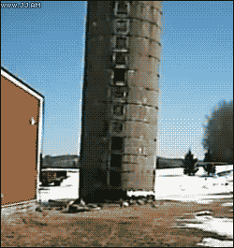
Collaboration Across Functional Areas
ISG Taskforce: Breaking Down Silos since 2017

Slide 13
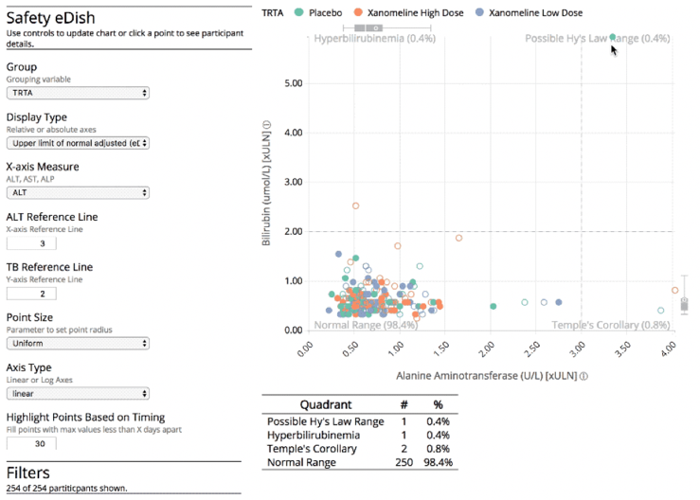
Collaboration Across Functional Areas
Three Key Components of safetyGraphics
Interactive Graphics
Interactive Graphics
Empower expert users to explore their data in real time
(and avoid digging through 18 page listings)

Slide 14
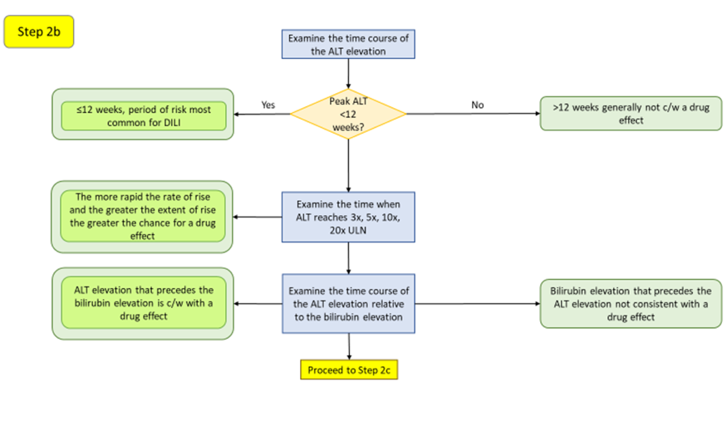
Collaboration Across Functional Areas
Three Key Components of safetyGraphics
Interactive Graphics
Clinical Workflow
Clinical Workflow
Pair graphic with a clinical workflow to guide evaluations based on the medical literature.

Slide 15
Collaboration Across Functional Areas
Three Key Components of safetyGraphics
Interactive Graphics
Clinical Workflow
Technical Platform
Technical Platform
Create a modular framework that makes it easy to load data, customize charts, and export your results as shareable reports.

Slide 16
safetyGraphics R package
Collaboration Across Functional Areas
Three Key Components of safetyGraphics
Interactive Graphics
Clinical Workflow
Technical Platform
A framework for evaluation of clinical trial safety
Links: CRAN | GitHub | Demo

Slide 17
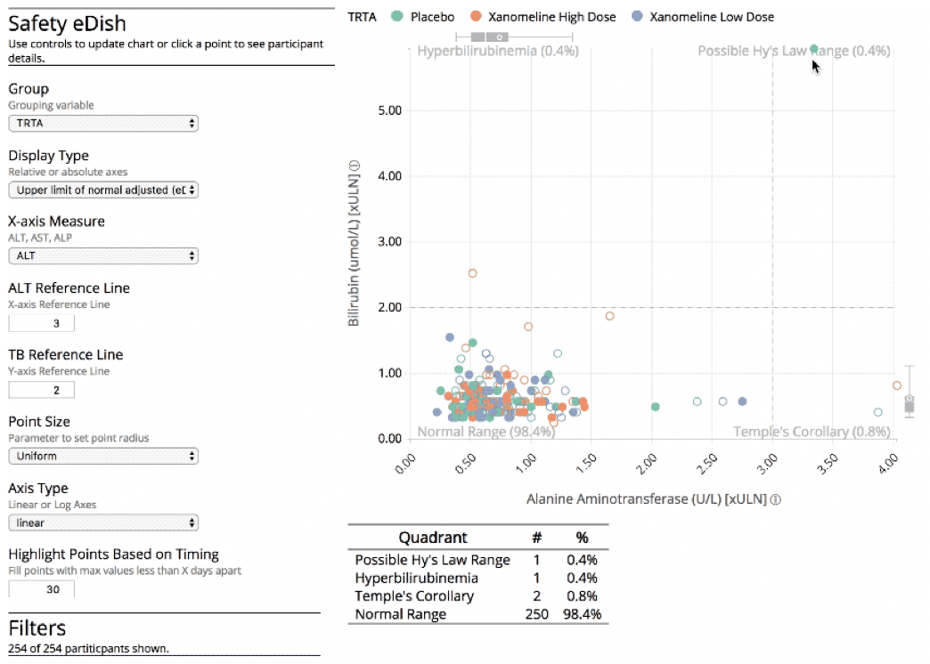
safetyGraphics Shiny App
CRAN | GitHub | Demo

Slide 18
safetyGraphics - Live on CRAN
CRAN | GitHub | Demo
Version 1.0 released to CRAN in June 2019
Pilot Testing
Tested by 9 organizations: FDA, Merck, Novartis, BI, Bayer, Abbvie, Lilly, J&J, Rho
All users reported that the tool met or exceeded expectations
None found it difficult to upload data using the R package
~50 specific comments / requests
Several teams working on pilot deployments
Presented to FDA Innovation Forum
For Exploratory Use Only
Package has been thoroughly tested, but is not validated (yet)

Slide 19
safetyGraphics - Technical Overview
Modular Shiny Application
5 modules: Home Page, Data, Settings, Charts, Export
Graphics Modules via htmlwidgets framework
Support for R functions (e.g. ggplot2), plotly and custom shiny modules coming in v1.1.
~2 dozen Helper functions
Detect Data Standards
Create and modify chart settings based on shiny inputs
378 unit tests with testthat package
Development Platform = GitHub + TravisCI
#Code to initialize shiny application with sample data
install_packages("safetyGraphics")
library("safetyGraphics")
safetyGraphicsApp()

Slide 20
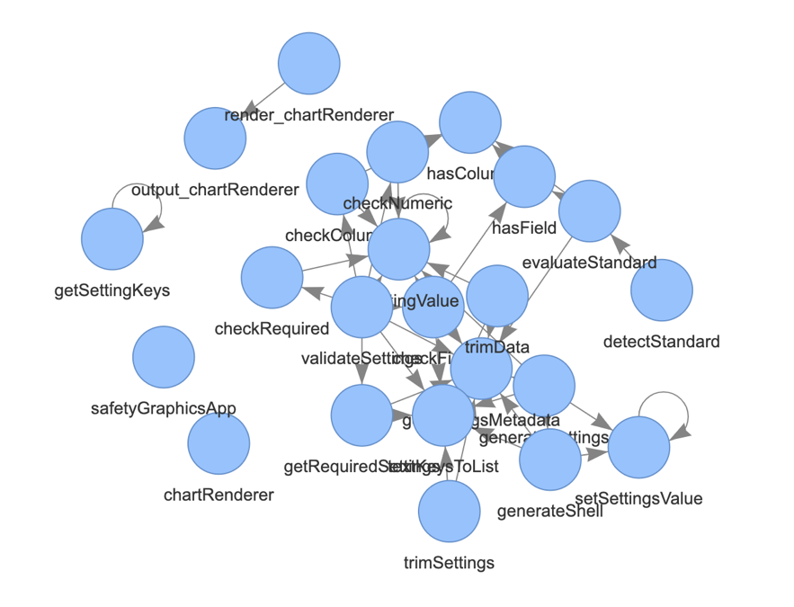
safetyGraphics – Modular Framework
Chart Code
safetyGraphics Package
hepExplorer
Shiny App
Metadata
Adverse Event Graphics
Helper Functions
Participant Profile Graphics
Javascript code
r code

Slide 21
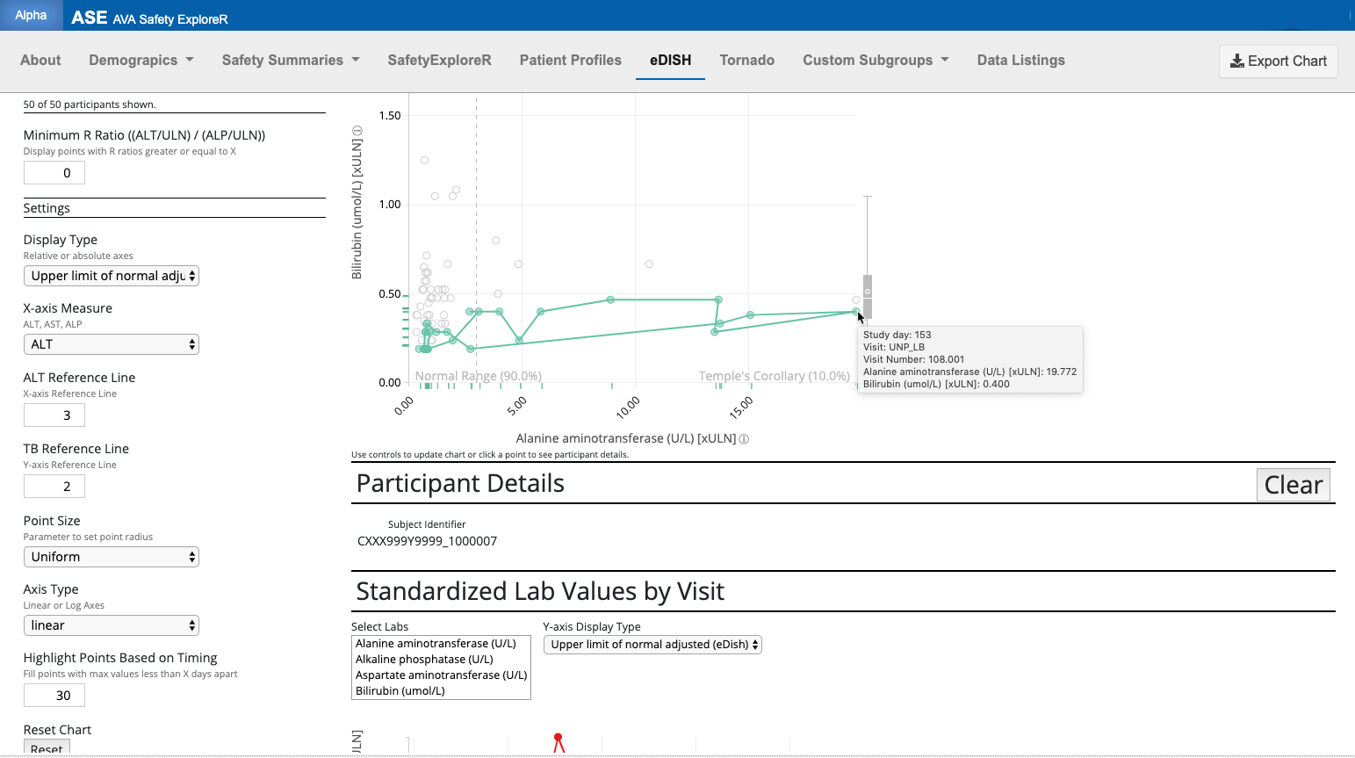
Case Study Open Source Collaboration in Pharma
With thanks to Xiao Ni, Novartis

Slide 22
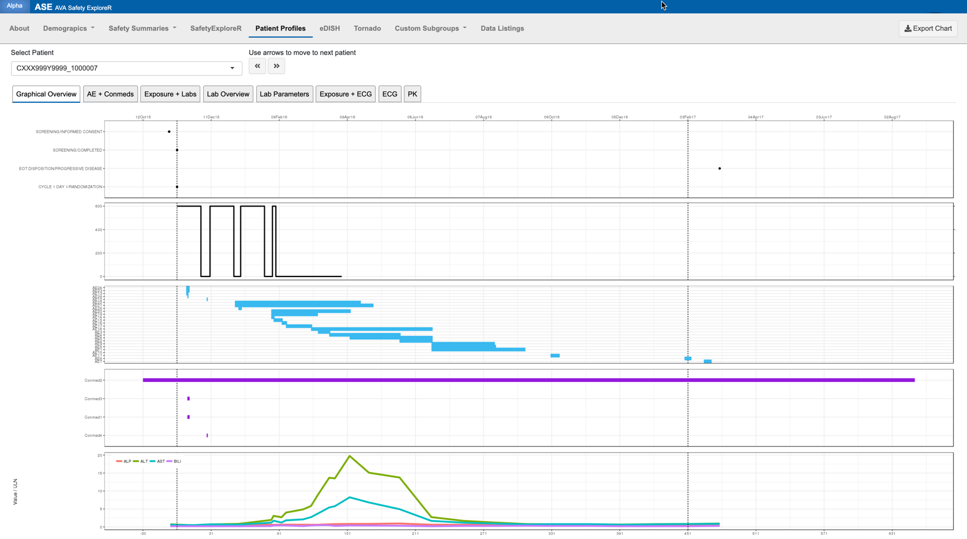
Case Study Open Source Collaboration in Pharma
Patient dropdown selector
Disposition
Treatment Exposure
AE
Concomitant medications
Liver function labs

Slide 23
Case Study Open Source Collaboration in Pharma
Disposition
Treatment Exposure
AE
Selecting patient from graph automatically links to same patient in the Patient Profiles tab
Concomitant medications
Liver function labs

Slide 24
Lessons Learned
Pharma is ready for Open Source Collaboration!
Cross-functional collaboration makes great tools - Collaboration between clinicians, statisticians and programmers provides a powerful combination of skills.
Industry Trend - Evolution of the tool across companies has already started organically.
Strong Business Case - Partnerships across industry can address a common need while reducing internal company resource expenditures to create and maintain custom tools (the interactive tools speak to a larger business need).
R Provides a Robust Toolset - Pushback to R in Pharma is trending downwards. Questions about validation remain, but there is good progress.

Slide 25
Future Development – Two Types of Collaboration
Chart & Workflow Creation
Improve existing charts
New Charts and Workflows:
Nephrotoxicity
QTc Prolongation
Volcano Plot Explorer
Recurrent AEs
Allergy/Immunology
Platform Improvements
Support Multiple Data Domains
Easy communication between charts
Embedded access to clinical workflows within the shiny app
Optimized graphics for studies with very large data sets
Facilitated “real-time” statistical analysis
Formalized Maintenance Model
All work done by volunteers, so …
You can help!!!
Email jeremy_wildfire@rhoworld.com
Fairly Straightforward!
Somewhat Complex

